Slide 1
GBD Vetting Plots
Betyna Berice and Natalie Pritchett

Slide 2
Background – Key Acronyms
CC – Cervical Cancer
CR – Cancer Registry
VR – Vital Registration
QA – Quality Assessment
GCPCT – Garbage Code Percentage

Slide 3
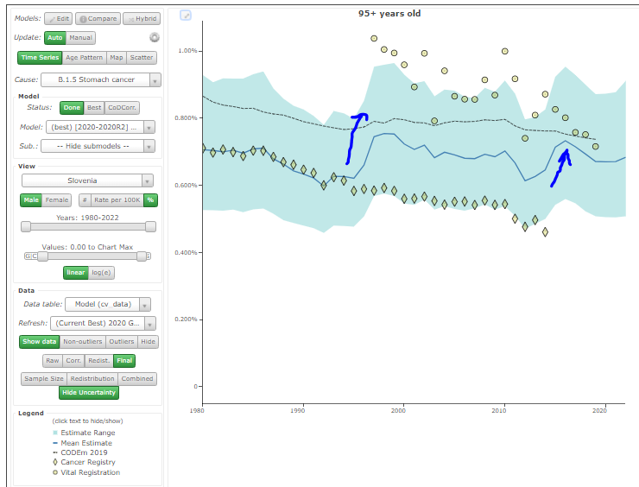
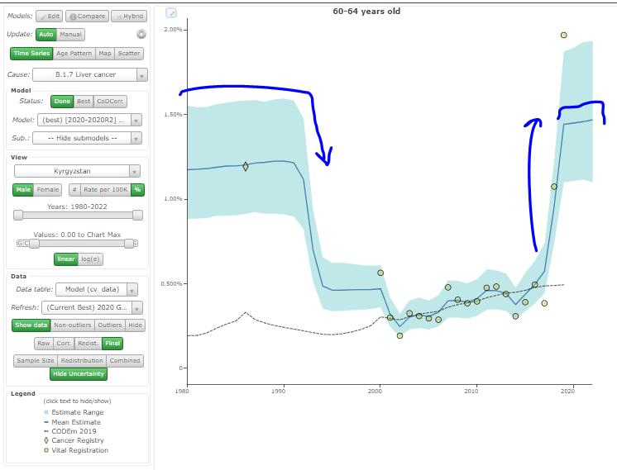
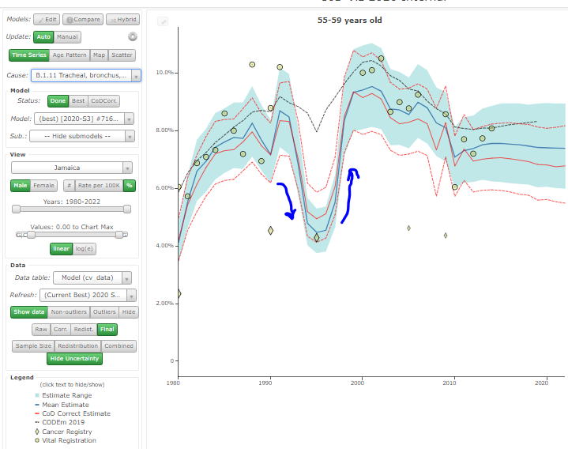
Background - Compositional Bias
Shifts due to overlaps, gaps, or distant data

Slide 4
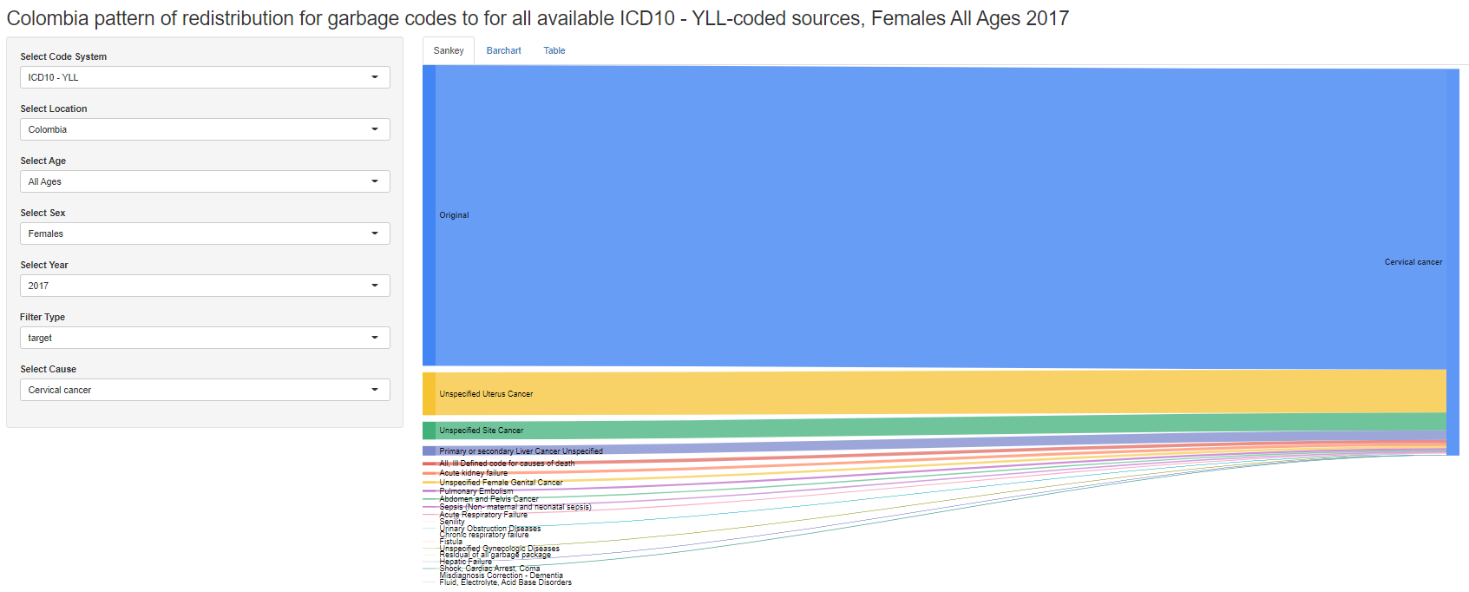

Background – Garbage codes
Garbage coded deaths are redistributed to target underlying causes of death by age, sex, location, and year
Some GBD causes receive a lot of garbage, while others receive very little

Slide 5
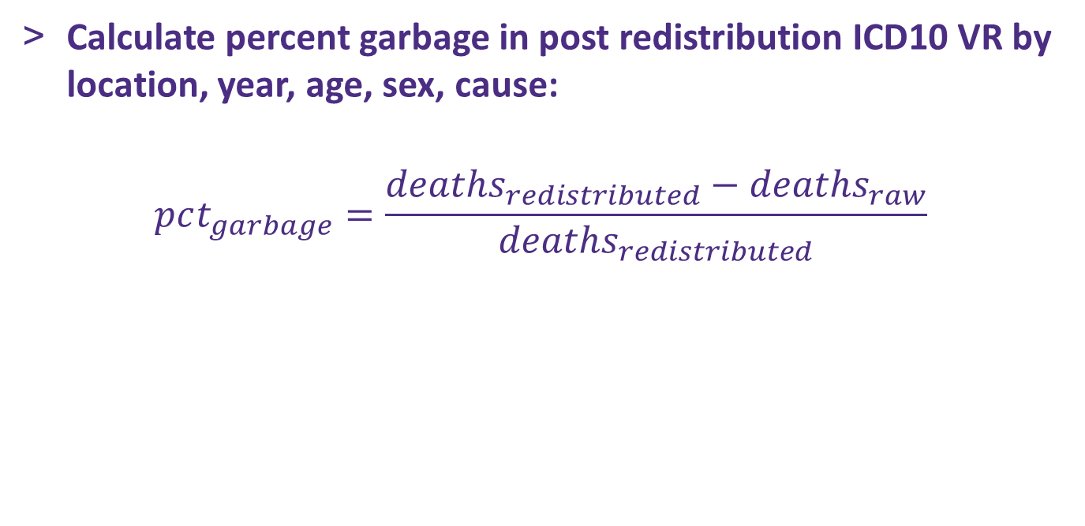
Background – Percent Garbage

Slide 6
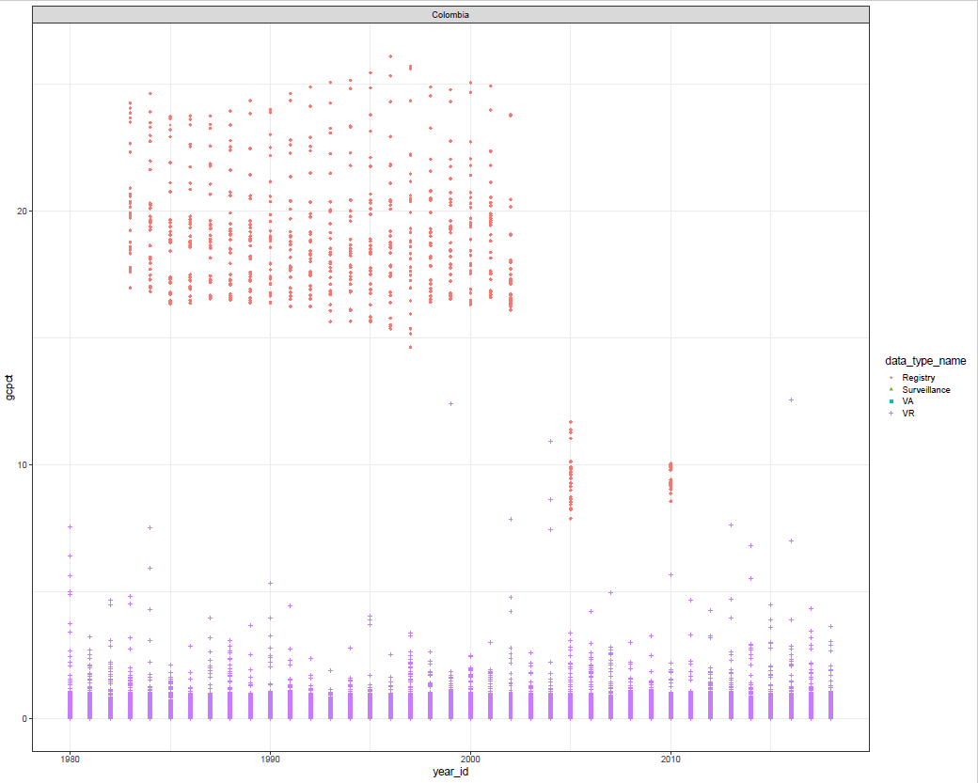
% Garbage Plots

Slide 7
## Set up libraries
rm(list=ls())
library(RColorBrewer)
library(data.table)
library(tidyverse)
library(ggforce)
library(“MASS”)
theme_set(theme_bw(16))

Slide 8
#Options for user to select
cause <- "cervical cancer"
sex_id <- 2
age_group_id <- c(5:21)
countries <- c("Colombia", "Costa Rica")
year_id <- c(1990:2015)

Slide 9
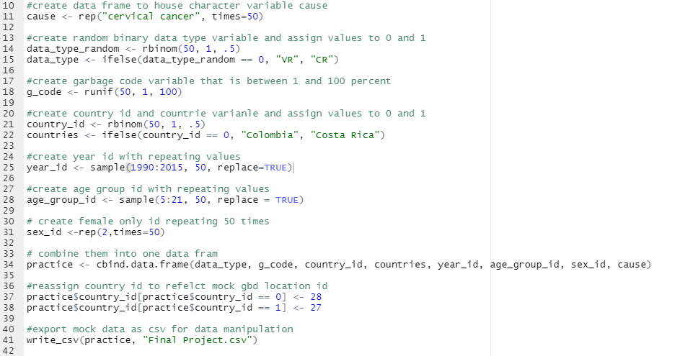
#Make dataset

Slide 10
#Make dataset continued
dat <- read.csv("Final Project.csv")

Slide 11
#Make plotting function
plotting_fct <- function(tbl, cause='cause',
sex_id='sex',
age_group_id='age_groups',
countries='countries',
year_id='years'){
print(ggplot(dat) +
geom_point(aes(x=year_id, y=g_code, color=data_type, shape=data_type, size=age_group_id)) +
facet_wrap_paginate(~countries, ncol = 1, nrow = 1, scales = "free", page = 1))
}

Slide 12
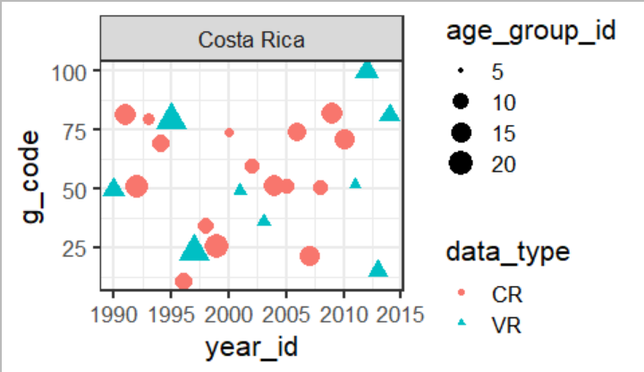
#Test plotting function for one country
plotting_fct(tbl = dat)

Slide 13
#Make a list to loop over
n <- length(unique(dat$country_id))

Slide 14
#Test printing pdf of multiple country plots using for loop
pdf(("garbage_code_qa.pdf"), width = 20, height = 16)
for(i in 1:n){
plotting_fct(tbl = dat)
}
dev.off()

Slide 15
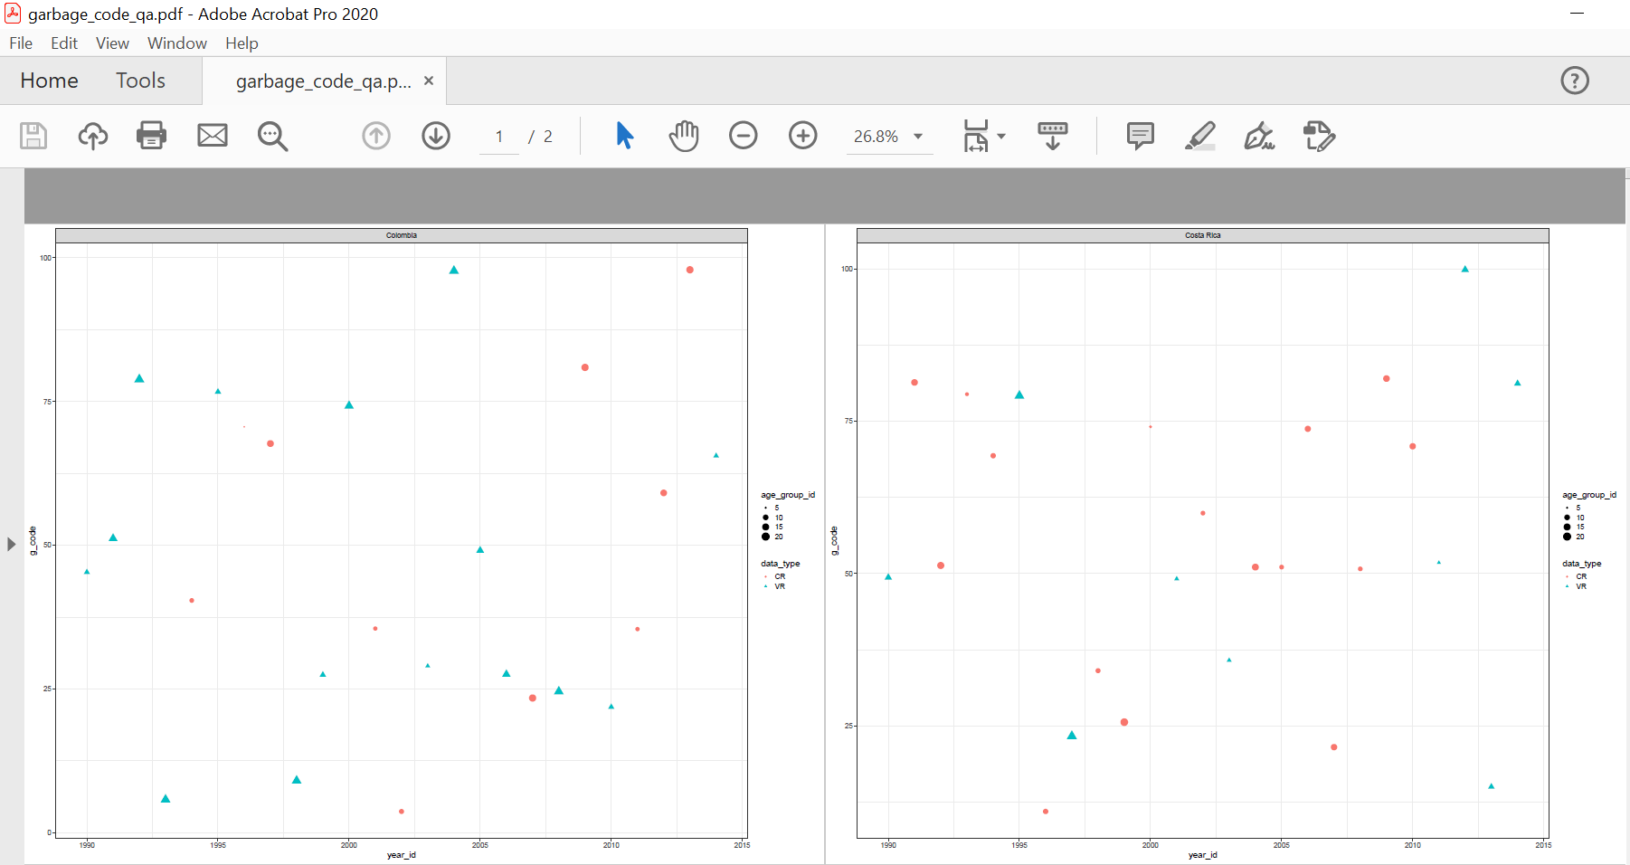
#Test printing pdf of multiple country plots using for loop

Slide 16

Thanks!

